Slide 1

Steganography: Hiding Data in Plain Sight
Steganography is the art of concealing information within plain sight. By embedding data within innocuous media like images or audio files, sensitive information can be discreetly transmitted without drawing unwanted attention.
by Jami Gowtham

Slide 2
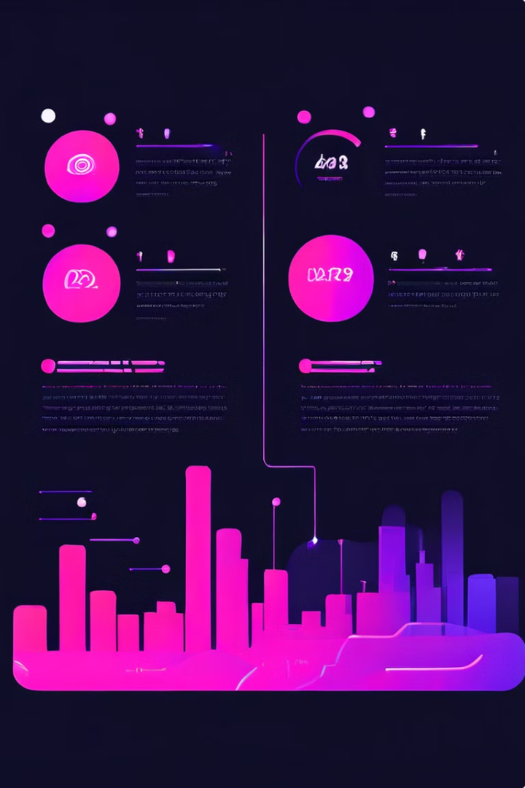
Agenda
1
Project Overview
Explore the core principles and applications of steganography.
2
End-User Insights
Understand the needs and challenges of those who utilize steganographic techniques.
3
Customized Solutions
Discuss how we can tailor steganographic approaches to meet specific requirements.
4
Technical Modeling
Delve into the technical aspects of implementing robust steganographic systems.

Slide 3
Project Overview
Core Principles
Applications
Challenges
Steganography relies on the concept of hiding information within innocuous media, such as images, audio, or video files.
Key applications include secure communications, copyright protection, and covert data storage.
Combating detection and ensuring the integrity of hidden data are critical challenges in steganography.

Slide 4





End-User Profiles
Government Agencies
Utilize steganography for secure communications and data protection.
Corporate Entities
Employ steganography to safeguard intellectual property and sensitive information.
Individual Users
Leverage steganography for personal privacy and secure data transmission.
Military/Intelligence
Adopt steganography for covert operations and intelligence gathering.

Slide 5

Innovative Solutions
Enhanced Security
Our steganographic techniques incorporate advanced encryption and authentication measures to ensure the confidentiality and integrity of hidden data.
Customizable Approach
We tailor our steganographic solutions to meet the unique requirements of each client, adapting to their specific use cases and constraints.
Robust Performance
Our solutions maintain high-quality output while minimizing the visual/auditory impact of hidden data, ensuring seamless integration with existing systems.
User-Friendly Design
We prioritize intuitive interfaces and simplified workflows, empowering end-users to leverage steganography effectively and efficiently.

Slide 6




Customized for Your Needs
Assessment
We begin by thoroughly understanding your specific requirements and constraints.
Tailored Approach
Our team then develops a customized steganographic solution that addresses your unique needs.
Seamless Integration
The solution is seamlessly integrated into your existing systems and workflows.

Slide 7

Technical Modeling
Embedding Techniques
Leveraging the least significant bits of digital media to conceal data without compromising quality.
Algorithmic Complexity
Implementing robust, high-entropy algorithms to enhance the security and detectability of hidden information.
Payload Capacity
Optimizing the amount of data that can be concealed within a given medium, while maintaining imperceptibility.
Steganographic Attacks
Developing detection and extraction countermeasures to safeguard against various steganographic attacks.

Slide 8

Measurable Results
Increased Security
Positive User Feedback
Our steganographic solutions have demonstrated a significant reduction in the risk of unauthorized data access and interception.
End-users have expressed high satisfaction with the intuitive interfaces and user-friendly experiences of our steganographic applications.
1
2
3
Enhanced Efficiency
Clients have reported improved productivity and streamlined workflows due to the seamless integration of our steganographic tools.

Slide 9

Explore Further
1
Steganography 101
Dive deeper into the fundamentals of steganography and its historical development.
2
Advanced Steganographic Techniques
Learn about cutting-edge methods for concealing data in various media formats.
3
Real-World Case Studies
Explore how organizations have successfully implemented steganographic solutions.

Slide 10

RESULT
Stego-Image: A modified image that contains the hidden text data.
Hidden Data: Text data successfully hidden in the image.
Extracted Data: Text data successfully extracted from the stego-image.
System Evaluation:- Security: The system ensures secure data hiding and extraction.
- Robustness: The system withstands common image processing operations.
- Capacity: The system hides a reasonable amount of text data.
Visual Fidelity: The stego-image maintains its original visual quality.
System Deployment: The system is ready for real-world applications.

